Slide 1
Digital Portfolio
STUDENT NAME: VISHWA EBENEZER
REGISTER NO AND NMID: 24BSCT146
1266F638E3A7D28989F4E077EABDFEE9
DEPARTMENT: COMPUTER TECHNOLOGY
COLLEGE: SRI KRISHNA ADITHYA COLLEGE OF ARTS AND SCIENCE

Slide 2
PORTFOLIO WEBSITE

Slide 3


AGENDA
Problem Statement
Project Overview
End Users
Tools and Technologies
Portfolio design and Layout
Features and Functionality
Results and Screenshots
Conclusion
Github Link
3/21/2024 Annual Review

Slide 4

PROBLEM STATEMENT
Develop a portfolio web page to showcase your works and other things related to you.
This web page may serve as a resume but it doesn’t filter out irrelevent topics like it does.

Slide 5

PROJECT OVERVIEW
This is a portfolio of mine where I could keep my followers updated through a web page. This may serve as a personal blog too!

Slide 6

WHO ARE THE END USERS?
The end users will be the people who would like to know more about me and also find a way to contact me.

Slide 7

TOOLS AND TECHNIQUES
IDE: Vim
Languages used: i) HTML
ii) CSS
iii) JavaScript

Slide 8
POTFOLIO DESIGN AND LAYOUT
The portfolio shall contain:
Links to my social medias including the links that the end users can use to contact me.
An About Me section.
My works.
List of skills I am capable of.
My experience.
The design of the web page must be simple yet creative.

Slide 9
FEATURES AND FUNCTIONALITY
The website contains hyperlinks that will lead to the pages that will lead the end users to what they want.
The website includes navigational buttons that would switch the page to sections.

Slide 10
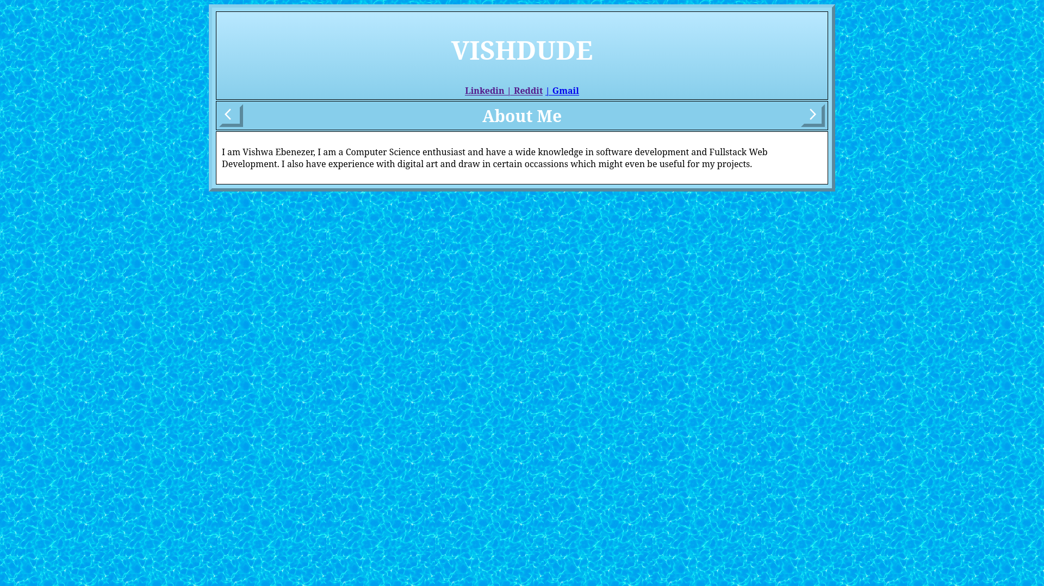
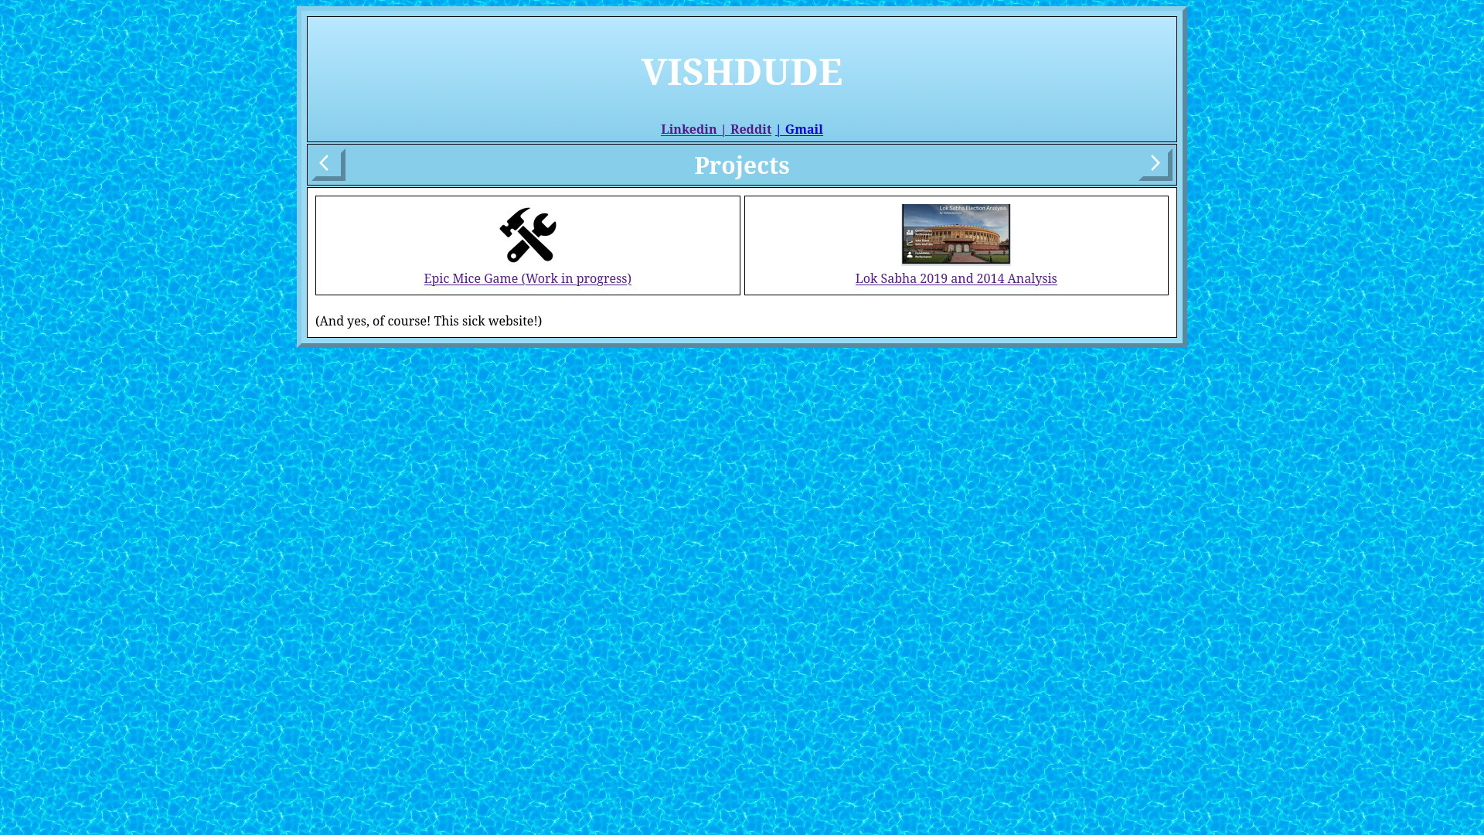

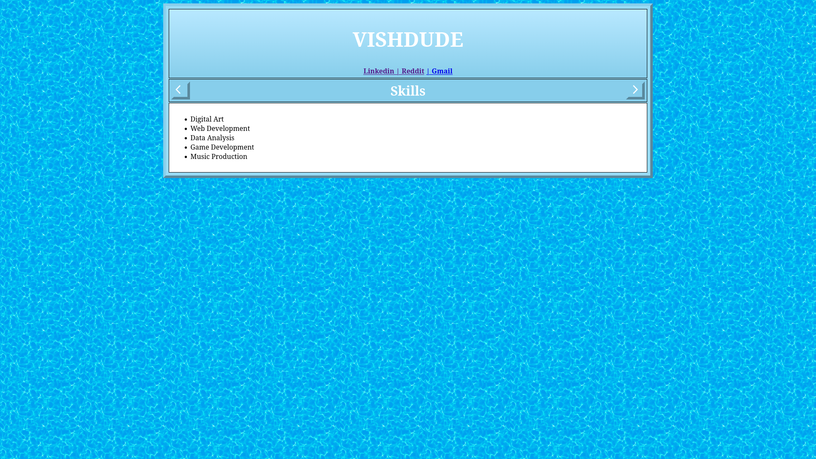
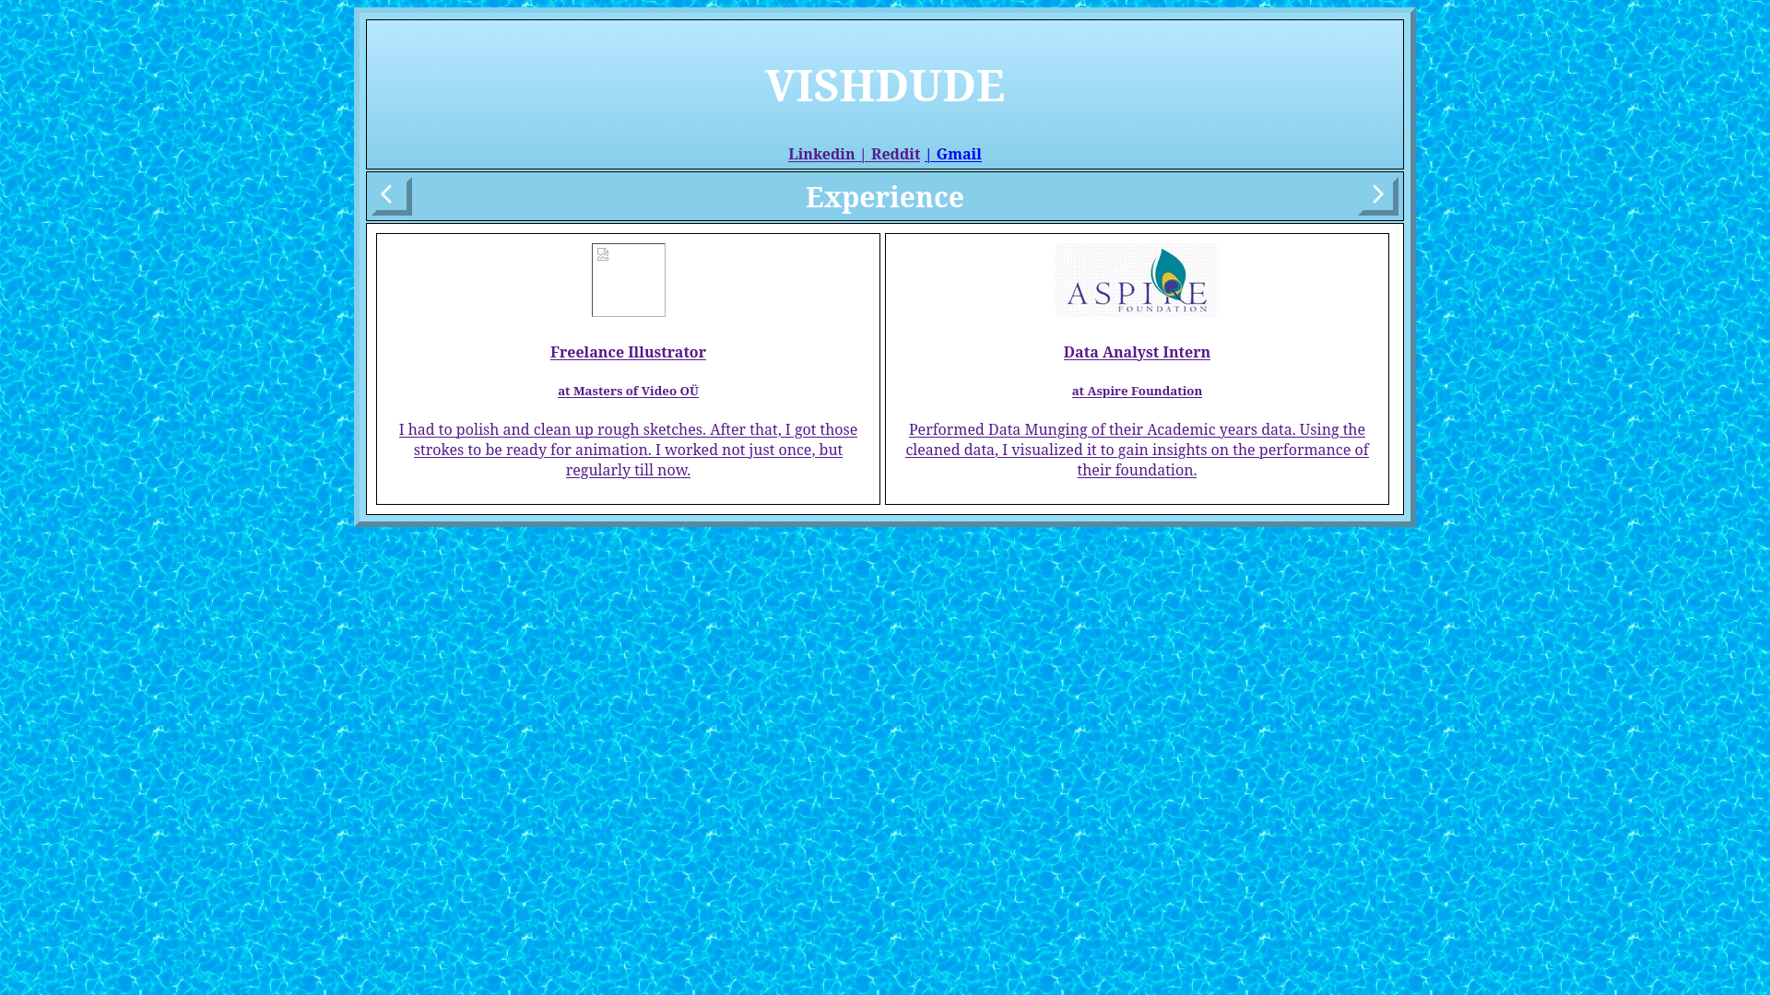
RESULTS AND SCREENSHOTS
3/21/2024 Annual Review

Slide 11
CONCLUSION
I won’t just draft this project right after the Edunet program. This is my third attempt on actually developing a personal portfolio.
This would be a really useful project that I could use throughout my carrreer.

